Slide 1
Welcome to CS430

Slide 2
Who Am I?
Education
Master's of Science in Computer Science
Studied Computer Science, Virtual Reality, Social Engineering and Cybersecurity at Colorado State University
Bachelor’s of Science in Computer Science
Focused on Networks and Security at Colorado State University
Teaching and Research
Research focus on Cybersecurity Education / Social Engineering / Virtual Reality Security
Interest in Visualization of cyberattacks using 3D VR Spaces
CSU DBSec Lab
Fun Facts
I play Dungeons and Dragons
I love Game Jams and Game Creation
My favorite Film Franchise is Starwars

Slide 3
Teaching Assistants
GTAs
Asif Uz Zaman

Slide 4
Communication

Slide 5
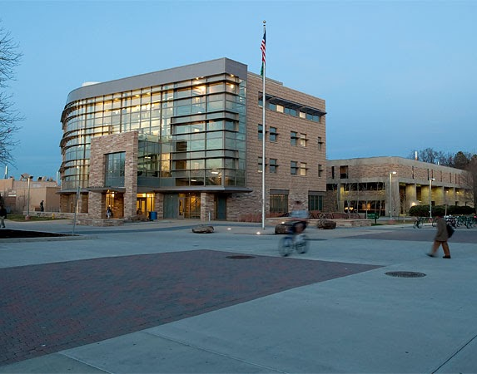
How to Contact the Team?
Ariana
TEAMS!
Course Email (compsci_cs430@colostate.edu)
Direct Email (Evan.Anspach@colostate.edu)
TAs
Only during their office hours
General questions
Post in the general channel!
Let’s other see the answer
Assignment Specific Questions
In the assignment channel
Check the Canvas, Teams, and Course website for Office Hours!
Hosted remotely

Slide 6
Teams Communication
Please remember to be respectful!
This is a professional environment, so act accordingly.
Do not post any code in the teams channel
Post assignment-specific questions in the channel created for that assignment
The general channel is for general course concerns Be professional.
Be courteous.
Do not post any questions about your grade or any grading issues. Such questions are private communication and must be emailed.
Do not post any opinions regarding your graded assignment or any aspect of the course. You will have a chance to submit anonymous reviews at the end of the semester. Email feedback to the instructor regarding the course is acceptable and welcome.

Slide 7
Course Logistics

Slide 8
Resources
Website: http://www.cs.colostate.edu/~cs430
Syllabus
Policies
Resources
Canvas
Lecture Slides (in modules section)
Assignments & Submissions
Quizzes
Assignment Grades
Course Email:
Compsci_cs430@colostate.edu
Lecture Recordings
Available within each module

Slide 9
Grading
Activity | Weight
Class Participation & Quizzes | 10%
Programming Projects | 40%
Midterms | 30%
Final Exam | 20%

Slide 10
Weekly Homework
Chapter Quizzes
Due Sundays at 11:59 PM
Lab Assignments
Due on Mondays and Fridays
They have an until by date

Slide 11
Exams
4 Unit exams

Slide 12
Course Policies

Slide 13
Late Policy
Turn things in on time!!
All labs have an until by date by which they are accepted with no penalty, past that there are no late submissions without SDC documentation
Exams will not be accepted late without proper documentation
For major life events work with Student Case management

Slide 14
Academic Integrity
Do your own work
Discussing assignments on a high level is ok
Collaboration is not allowed unless explicitly stated
Anyone in violation of this policy will receive a -100 on the assignment and be reported to the university for the first offense.
Second offense will result in failure of the class

Slide 15
Generative AI
DO NOT DO IT
Zero tolerance policy
Full policy can be found here:
https://www.cs.colostate.edu/~cs356/#/policies

